Slide 1
Android Studio-----Android
@vijay

Slide 2
Android is a complete set of software for mobile devices such as tablet computers, notebooks, smartphones, electronic book readers, set-top boxes etc.
It contains a linux-based Operating System, middleware and key mobile applications. It can be thought of as a mobile operating system. But it is not limited to mobile only. It is currently used in various devices such as mobiles, tablets, televisions etc.
@vijay

Slide 3
What is Android
Android is a software package and linux based operating system for mobile devices such as tablet computers and smartphones.
It is developed by Google and later the OHA (Open Handset Alliance). Java language is mainly used to write the android code even though other languages can be used.
The goal of android project is to create a successful real-world product that improves the mobile experience for end users.
@vijay

Slide 4
What is Open Handset Alliance (OHA)
It's a consortium of 84 companies such as google, samsung, AKM, synaptics, KDDI, Garmin, Teleca, Ebay, Intel etc.
It was established on 5th November, 2007, led by Google. It is committed to advance open standards, provide services and deploy handsets using the Android Plateform.
@vijay

Slide 5
Features of Android
1) It is open-source.
2) Anyone can customize the Android Platform.
3) There are a lot of mobile applications that can be chosen by the consumer.
4) It provides many interesting features like weather details, opening screen, live RSS (Really Simple Syndication) feeds etc.
It provides support for messaging services(SMS and MMS), web browser, storage (SQLite), connectivity (GSM, CDMA, Blue Tooth, Wi-Fi etc.), media, handset layout etc.
@vijay

Slide 6
Categories of Android applications
There are many android applications in the market. The top categories are:
Entertainment
Tools
Communication
Productivity
Personalization
Music and Audio
Social
Media and Video
Travel and Local etc.
@vijay

Slide 7
History of Android
The history and versions of android are interesting to know. The code names of android ranges from A to J currently, such as Aestro, Blender, Cupcake, Donut, Eclair, Froyo, Gingerbread, Honeycomb, Ice Cream Sandwitch, Jelly Bean, KitKat and Lollipop. Let's understand the android history in a sequence.
1) Initially, Andy Rubin founded Android Incorporation in Palo Alto, California, United States in October, 2003.
2) In 17th August 2005, Google acquired android Incorporation. Since then, it is in the subsidiary of Google Incorporation.
3) The key employees of Android Incorporation are Andy Rubin, Rich Miner, Chris White and Nick Sears.
@vijay

Slide 8
4) Originally intended for camera but shifted to smart phones later because of low market for camera only.
5) Android is the nick name of Andy Rubin given by coworkers because of his love to robots.
6) In 2007, Google announces the development of android OS.
7) In 2008, HTC launched the first android mobile.
@vijay

Slide 9
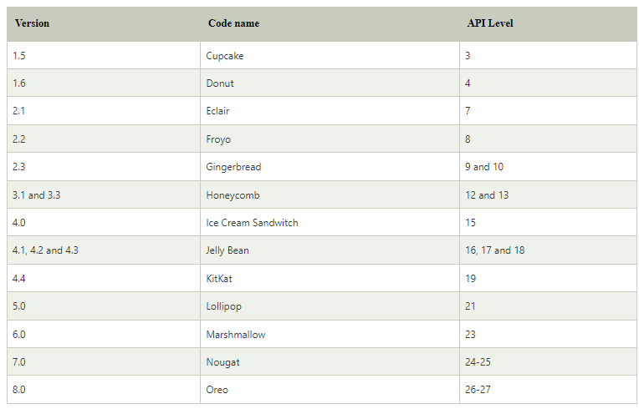
Android Versions, Codename and API
@vijay

Slide 10
Name | Internal codename[9] | Version number(s) | API | Initial stable
 |  |  | level | release date
Android 10 | Quince Tart | 10 | 29 | September 3, 2019
Android 11 | Red Velvet Cake | 11 | 30 | September 8, 2020
Android 12 | Snow Cone | 12 | 31 | October 4, 2021
Android 12L | Snow Cone v2 | 12.1[a] | 32 | March 7, 2022
Android 13 | Tiramisu | 13 | 33 | August 15, 2022
@vijay

Slide 11
Android Architecture
Android architecture or Android software stack is categorized into five parts:
linux kernel
native libraries (middleware),
Android Runtime
Application Framework
Applications
@vijay

Slide 12
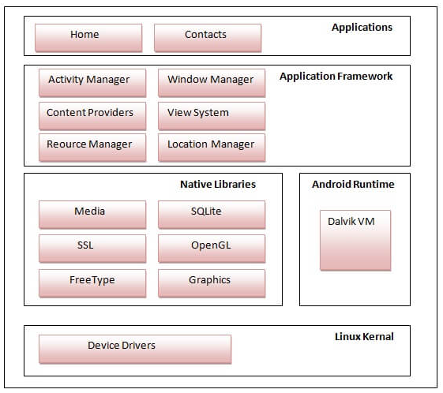
@vijay

Slide 13
Linux kernel
It is the heart of android architecture that exists at the root of android architecture. Linux kernel is responsible for device drivers, power management, memory management, device management and resource access.
@vijay

Slide 14
Native Libraries
On the top of linux kernel, their are Native libraries such as WebKit, OpenGL, FreeType, SQLite, Media, C runtime library (libc) etc.
The WebKit library is responsible for browser support, SQLite is for database, FreeType for font support, Media for playing and recording audio and video formats.
@vijay

Slide 15
Android Runtime
In android runtime, there are core libraries and DVM (Dalvik Virtual Machine) which is responsible to run android application. DVM is like JVM but it is optimized for mobile devices. It consumes less memory and provides fast performance.
@vijay

Slide 16
Android Framework
On the top of Native libraries and android runtime, there is android framework. Android framework includes Android API's such as UI (User Interface), telephony, resources, locations, Content Providers (data) and package managers. It provides a lot of classes and interfaces for android application development.
@vijay

Slide 17
Applications
On the top of android framework, there are applications. All applications such as home, contact, settings, games, browsers are using android framework that uses android runtime and libraries. Android runtime and native libraries are using linux kernal.
@vijay

Slide 18
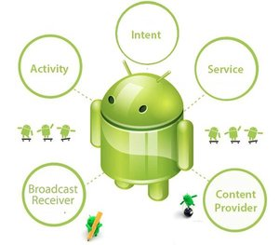
Android Core Building Blocks
An android component is simply a piece of code that has a well defined life cycle e.g. Activity, Receiver, Service etc.
The core building blocks or fundamental components of android are activities, views, intents, services, content providers, fragments and AndroidManifest.xml.
@vijay

Slide 19
Activity
An activity is a class that represents a single screen. It is like a Frame in AWT.
View
A view is the UI element such as button, label, text field etc. Anything that you see is a view.
@vijay

Slide 20
Intent
Intent is used to invoke components. It is mainly used to:
Start the service
Launch an activity
Display a web page
Display a list of contacts
Broadcast a message
Dial a phone call etc.
@vijay

Slide 21
Service
Service is a background process that can run for a long time.
There are two types of services local and remote. Local service is accessed from within the application whereas remote service is accessed remotely from other applications running on the same device.
Content Provider
Content Providers are used to share data between the applications.
@vijay

Slide 22
Fragment
Fragments are like parts of activity. An activity can display one or more fragments on the screen at the same time.
AndroidManifest.xml
It contains informations about activities, content providers, permissions etc. It is like the web.xml file in Java EE/Kotlin.
@vijay

Slide 23
Android Virtual Device (AVD)
It is used to test the android application without the need for mobile or tablet etc. It can be created in different configurations to emulate different types of real devices.
@vijay

Slide 24
Android Emulator
The Android emulator is an Android Virtual Device (AVD), which represents a specific Android device. We can use the Android emulator as a target device to execute and test our Android application on our PC. The Android emulator provides almost all the functionality of a real device. We can get the incoming phone calls and text messages. It also gives the location of the device and simulates different network speeds. Android emulator simulates rotation and other hardware sensors. It accesses the Google Play store, and much more
@vijay

Slide 25
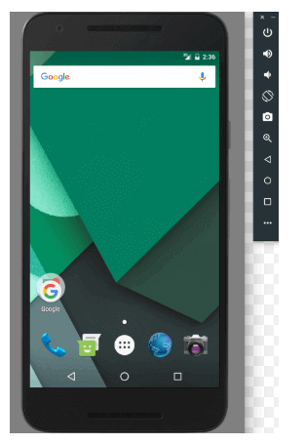
Android Emulator
If we want to clear the data from an emulator and return it to the initial state when it was first defined, then right-click an AVD and select Wipe Data. Or click menu ▼ and select Wipe Data.
@vijay

Slide 26
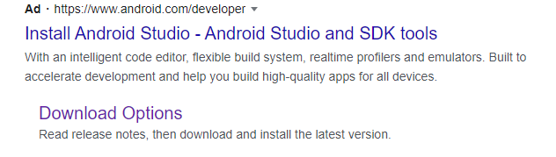
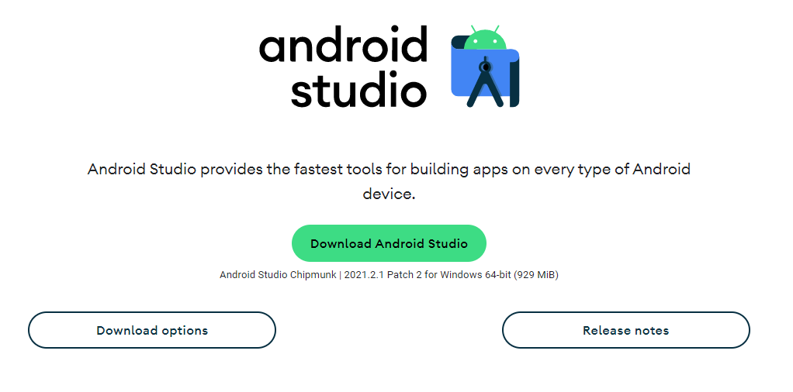
Install Android
@vijay

Slide 27
Dalvik Virtual Machine | DVM
The Dalvik Virtual Machine (DVM) is an android virtual machine optimized for mobile devices. It optimizes the virtual machine for memory, battery life and performance.
Dalvik is a name of a town in Iceland. The Dalvik VM was written by Dan Bornstein.
The Dex compiler converts the class files into the .dex file that run on the Dalvik VM. Multiple class files are converted into one dex file.
@vijay

Slide 28
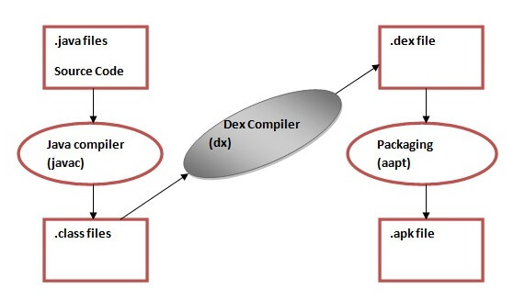
compiling and packaging process from the source file:
The javac tool compiles the java source file into the class file.
The dx tool takes all the class files of your application and generates a single .dex file. It is a platform-specific tool.
The Android Assets Packaging Tool (aapt) handles the packaging process.
@vijay

Slide 29
AndroidManifest.xml
The AndroidManifest.xml file contains information of your package, including components of the application such as activities, services, broadcast receivers, content providers etc.
It performs some other tasks also:
  It is responsible to protect the application to access any protected parts by providing the permissions.
  It also declares the android api that the application is going to use.
  It lists the instrumentation classes. The instrumentation classes provides profiling and other informations. These informations are removed just before the application is published etc.
@vijay

Slide 30
Elements of the AndroidManifest.xml file
This is the required xml file for all the android application and located inside the root directory.
<manifest>
manifest is the root element of the AndroidManifest.xml file. It has package attribute that describes the package name of the activity class.
<application>
application is the subelement of the manifest. It includes the namespace declaration. This element contains several subelements that declares the application component such as activity etc.
The commonly used attributes are of this element are icon, label, theme etc.
@vijay

Slide 31
android:icon represents the icon for all the android application components.
android:label works as the default label for all the application components.
android:theme represents a common theme for all the android activities.
<activity>
activity is the subelement of application and represents an activity that must be defined in the AndroidManifest.xml file. It has many attributes such as label, name, theme, launchMode etc.
@vijay

Slide 32
android:label represents a label i.e. displayed on the screen.
android:name represents a name for the activity class. It is required attribute.
<intent-filter>
intent-filter is the sub-element of activity that describes the type of intent to which activity, service or broadcast receiver can respond to.
<action>
It adds an action for the intent-filter. The intent-filter must have at least one action element.
@vijay

Slide 33
<category>
It adds a category name to an intent-filter.
@vijay

Slide 34
Android R.java file
Android R.java is an auto-generated file by aapt (Android Asset Packaging Tool) that contains resource IDs for all the resources of res/ directory.
If you create any component in the activity_main.xml file, id for the corresponding component is automatically created in this file. This id can be used in the activity source file to perform any action on the component.
@vijay

Slide 35
Android - Activities
If you have worked with C, C++ or Java programming language then you must have seen that your program starts from main() function. Very similar way, Android system initiates its program with in an Activity starting with a call on onCreate() callback method. There is a sequence of callback methods that start up an activity and a sequence of callback methods that tear down an activity as shown in the below Activity life cycle diagram: (image courtesy : android.com )
@vijay

Slide 36
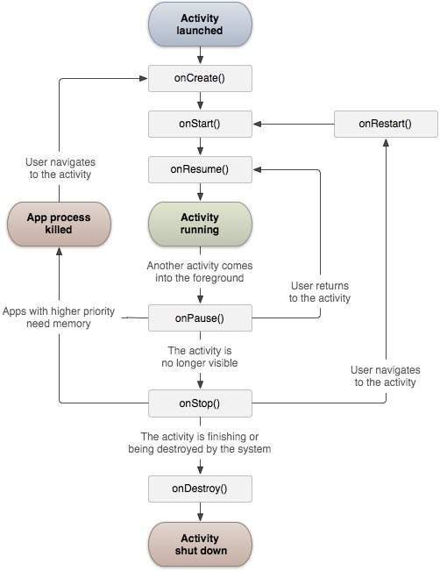

@vijay

Slide 37
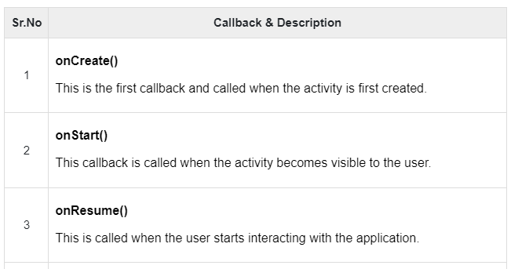
@vijay

Slide 38
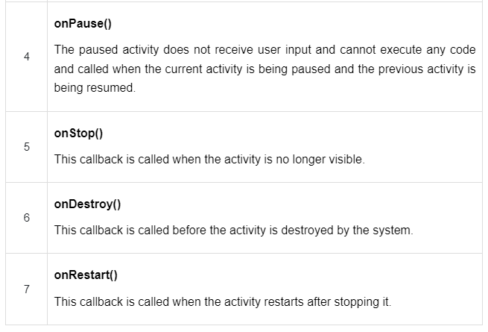
@vijay

